Slide 1
Nyheter 2024
Bauscher
Schönwald
Playground
WMF
HEPP
Zwiesel Glas

Slide 2
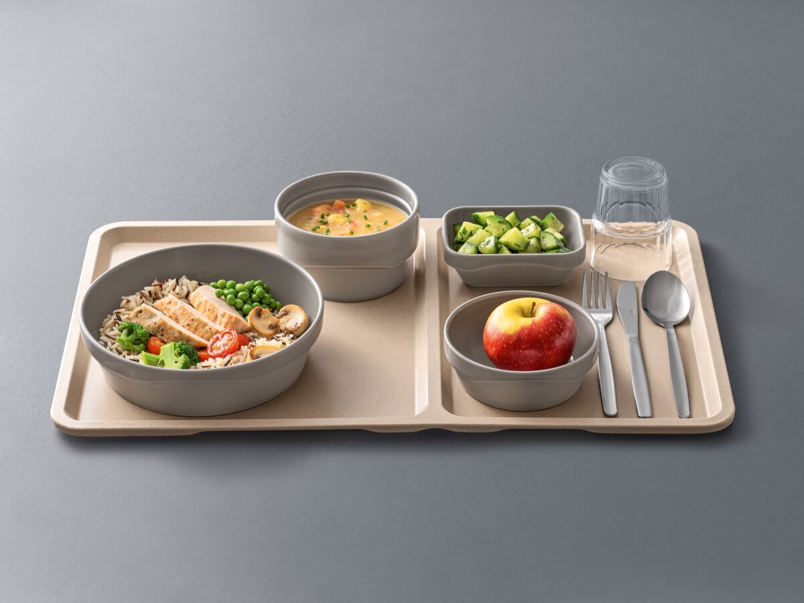
Bauscher AIRFLOW ESSENTA
The first hospital porcelain with coloured glaze
Range is mainly based on Bauscher Airflow and can be used for all meals
Glazed in colour GRAY
Compatible with convection technology and contact heat
On stock as of Q1/2024

Slide 3
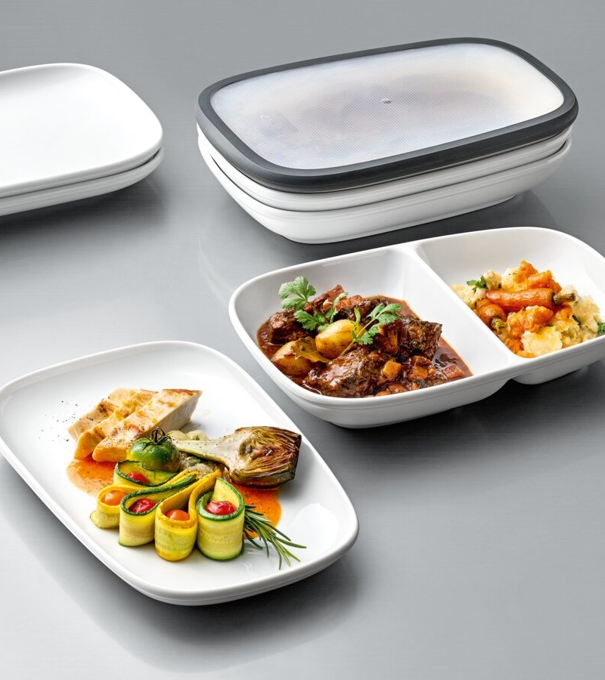
Bauscher REUSABLE
› Contents of the bowls designed for usual portion sizes ( usable capacity approx. 500 ml )
› no need to transfer the food
› soft inner shapes make it easy to take out the food ( plate character )
› soft inner shapes mean no corners for dirt; better washing result
› space-saving stackability
› high-quality reusable solution; reusable and therefore sustainable
› the combination of porcelain items with the plastic cover results in a spill-proof reusable solution that is also suitable for use To-Go

Slide 4
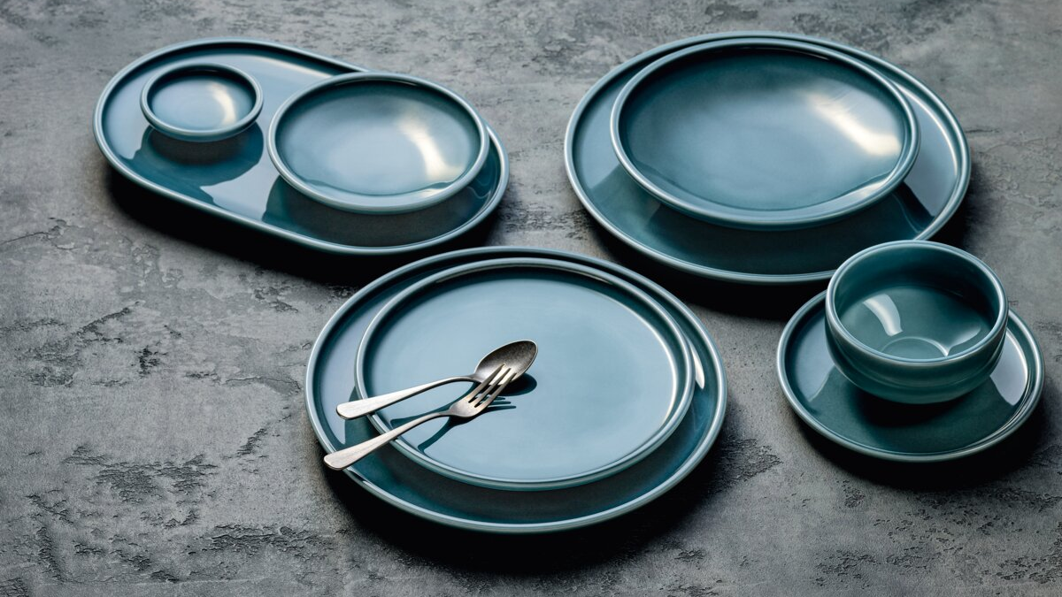
Schönwald COMPANION
Dining concept in petrol blue coloured glaze
Plates, platters and bowls will be available
The coloured glaze gives the plain items a lively, handcrafted surface
Marketing in mix & match with Playground
Pricing similar to coloured glazes STEAM & FROST
Supplementary decor concept in progress
On stock as of Q1/2024 (a part of the collection is already on stock)

Slide 5
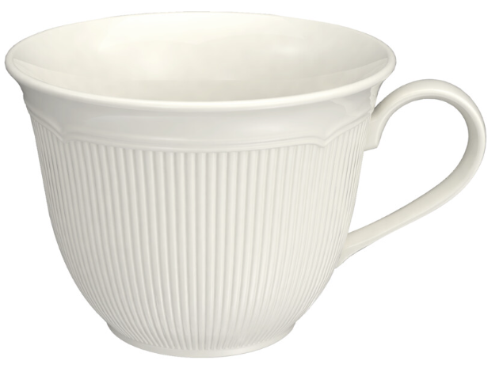
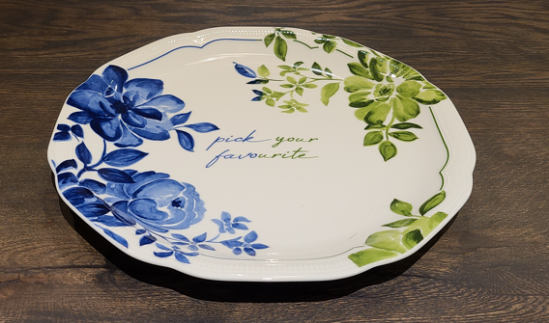
SCHÖNWALD CREATE
Transfer of the Create collection from the Bauscher brand to the Schönwald brand
Takeover of all items, except all cups & saucers
Re-Design of the cups
Addition of two rim plates to the range
Perfect combination with Delight Cups & saucers are compatible)
Decoration concepts are in progress (see left)
New items will be on stock latest as of 05/2024

Slide 6
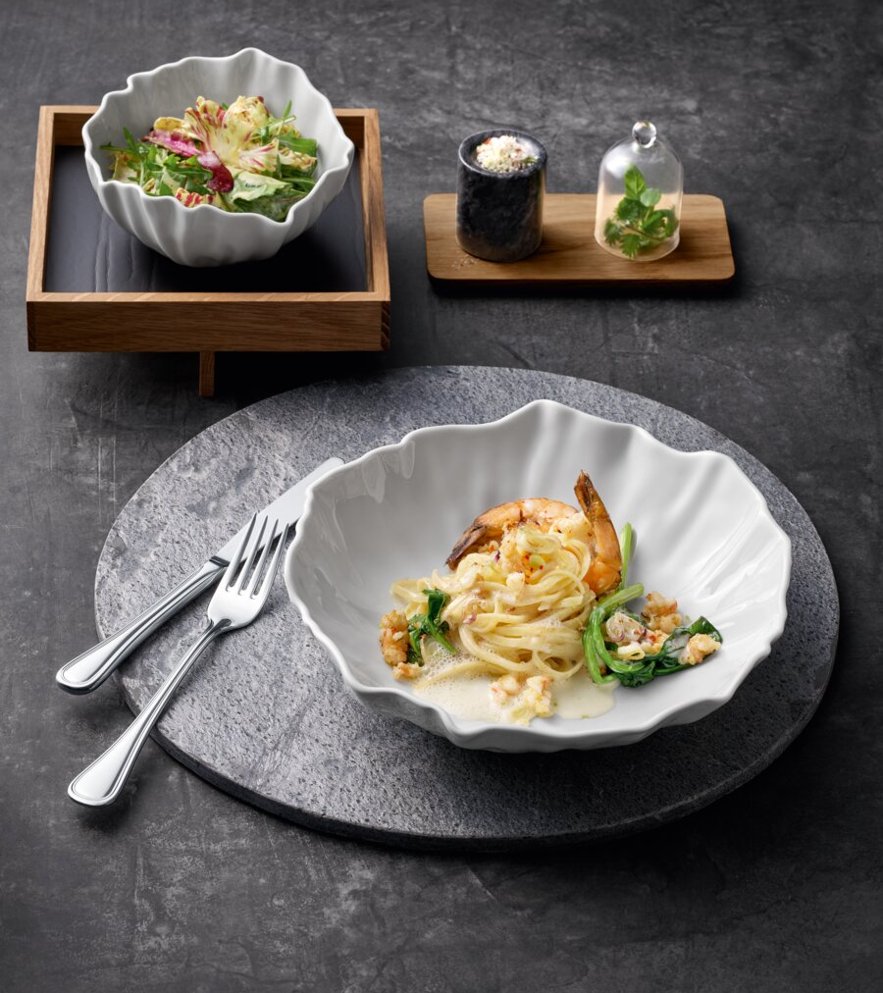
Schönwald SHOWPIECES MATT
Highlight range with items from Essentials & Showpieces
New interpretation of existing items with matt surfaces
Matting is achieved by sanblasting
Food presentation are as remain glazed
Attractive pricing (Column Light)
Items will be available from stock
On stock as of 02/2024

Slide 7
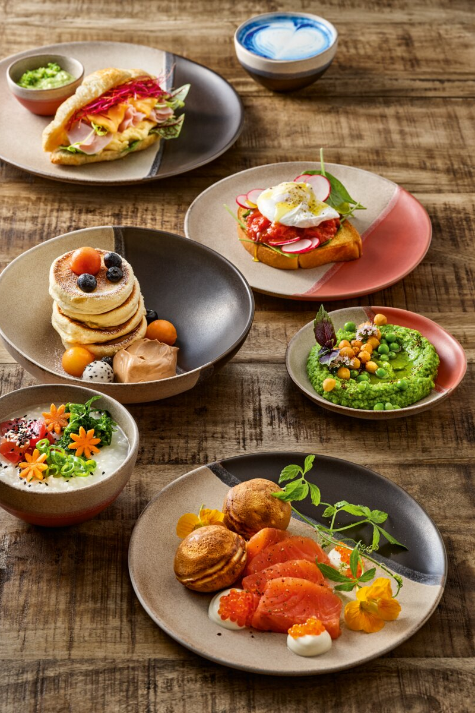
Playground SPOT ON
Stoneware collection of soft and imperfect-looking items with dipped colour parts
Matt surface in basic color grey/brown
Dipped colours available in coral and black
Designed exclusively for Playground
On stock as of 01/2024

Slide 8
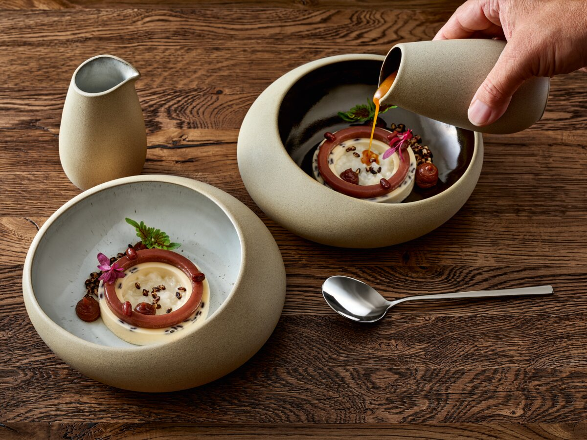
Playground EMBRACE
Collection made of Eco-Gres® with a soft design language and a natural, nest-like look
Matt outer surfaces
Glaze available in glossy black and light effect glaze
Designed exclusively for Playground
On stock as of 02/2024

Slide 9
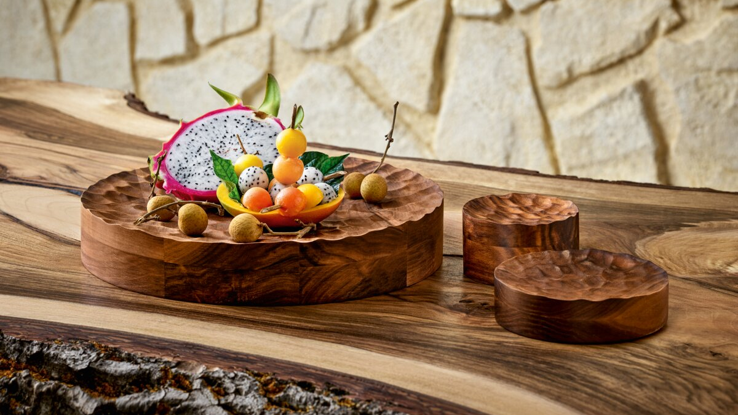
Playground ELEVATE
Plateau elements made of wood with carved surface structure
Available in oak and walnut
Designed exclusively for Playground
On stock as of 03/2024

Slide 10
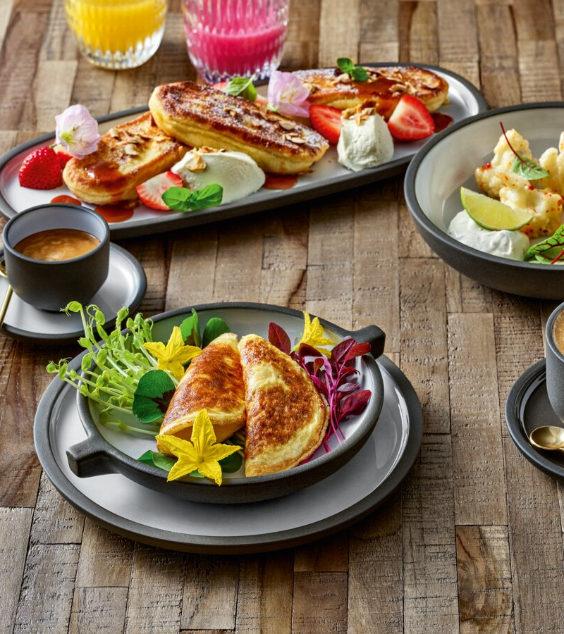
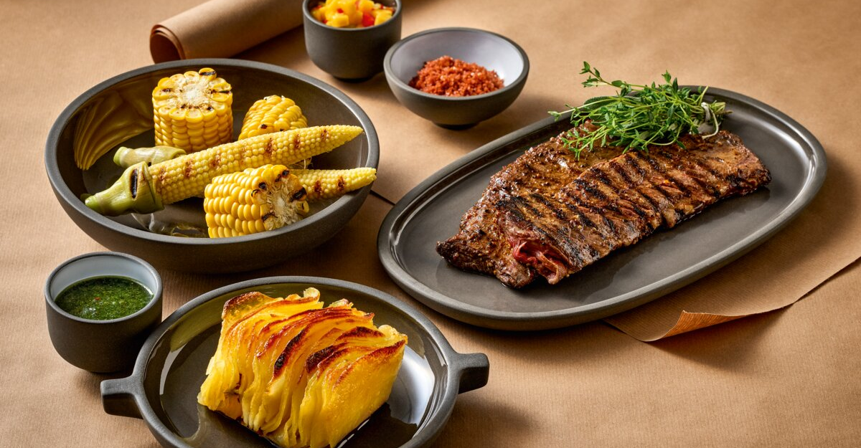
Playground RENEW (new items)
Expansion of the item range in the ReNew collection
Addition of various plates and cups
Available in taupe and white
Design by Carsten Gollnick, exclusively for Playground
On stock as of 03/2024

Slide 11
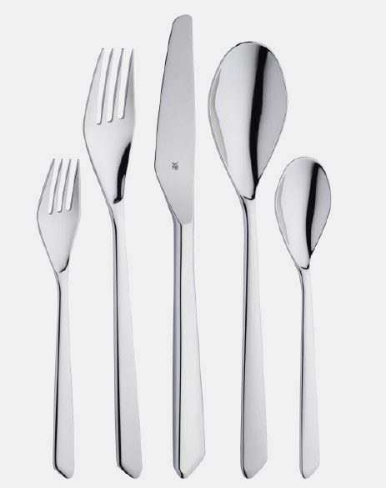
WMF SHADES
The perfect addition: SHADES —NEW!
Whether a classic or modern ambience: SHADES shines in its clear design and is the ideal addition for fine dining. With refined details such as the tapered silhouette, the diagonal prong area and the unusual blade and spoon shape, the cutlery adds a bold touch to every table setting.

Slide 12
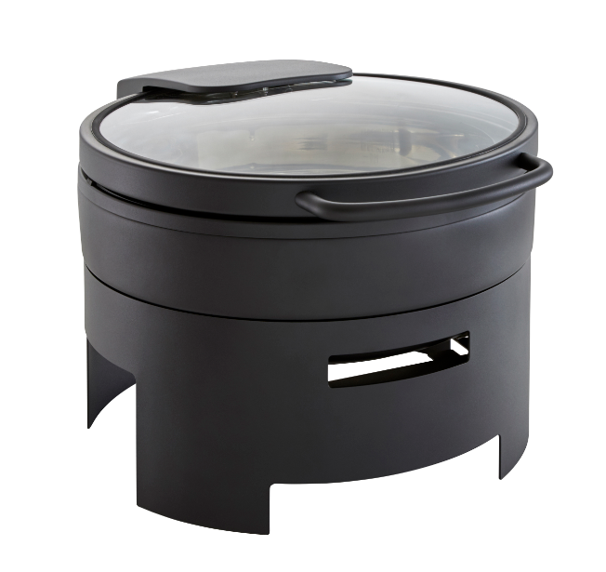
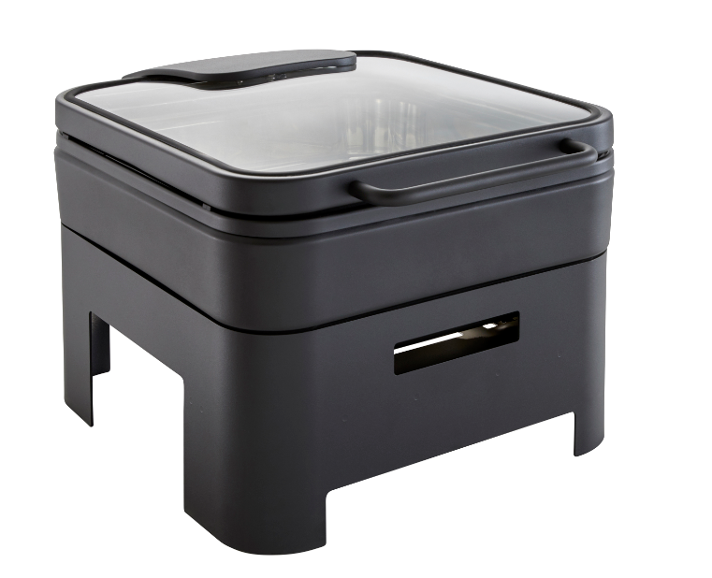
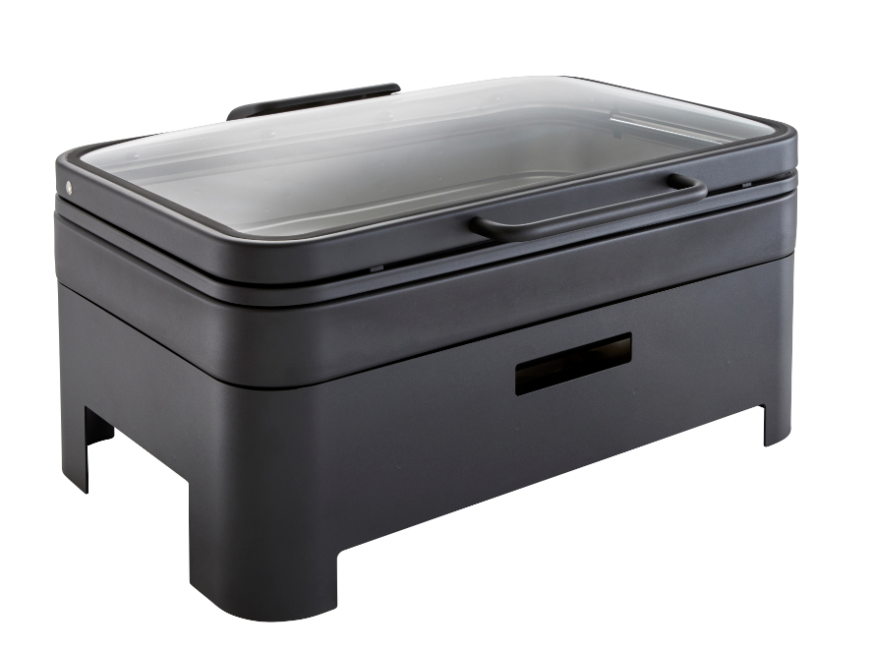
WMF Hot & Fresh Black
⋅Modern Design:
Modern, timeless black design, made of a long lastingpower coating
⋅Hot and fresh for longer:
Transparent glass lids reduce the frequent opening of
chafing dishes and save energy.
⋅User-friendliness:
The lid is child’s play to open, fix in any position and gently close.
⋅Suitable for induction hobs:
WMF TransTherm® bases ensure perfect heat
distribution on induction and heating elementsorwithfuel.
⋅Neutral taste and low-maintenance,
made of quality Cromargan®, dishwasher-safe.

Slide 13
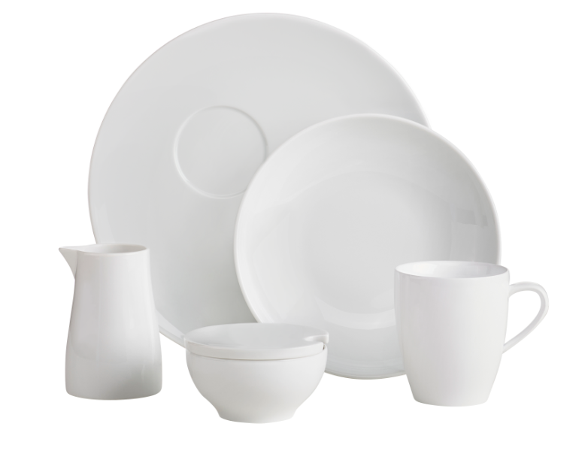
WMF BALANCE
Timelessly simple design, a variety of possibilities for use.
We present our new porcelain series: WMF BALANCE. (Hard porcelain)
It captivates through its simplicity as well as its calm
and elegant design, allowing a wide variety of
specialitydishes to be presented with creative flair.

Slide 14
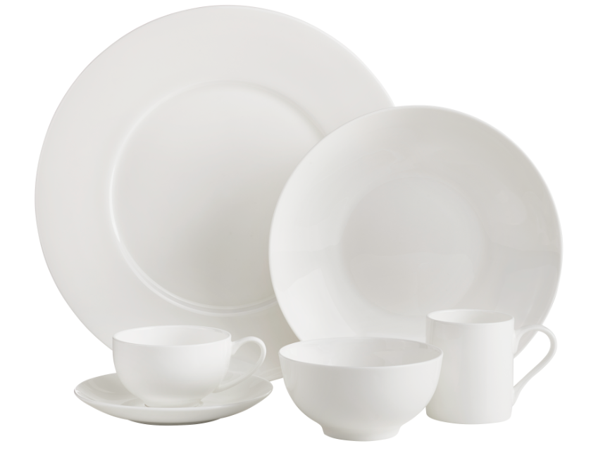
WMF AVA
Our bone china series WMF AVA —NEW!
Lightness in virtually transparent beauty: WMF AVA is
made of bone china—one of the finest porcelains.
The extraordinary brilliance and the pleasant surface feel
make WMF AVA a real eye-catcher that enhances every
sophisticated fine dining setting. With an extremely wide
selection, this series meets even the highest demands.

Slide 15
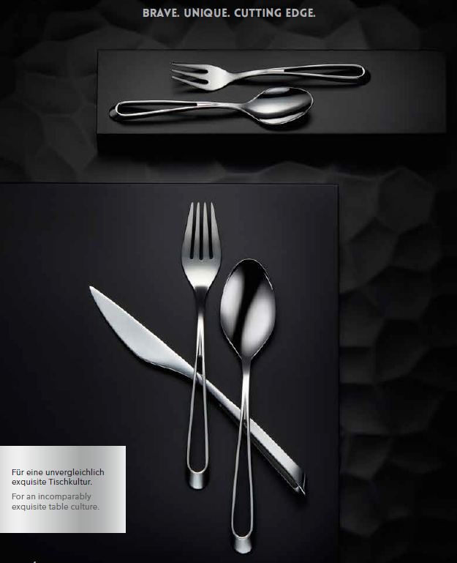
HEPP CUTTING EDGE
An eye-catcher par excellence:
HEPP Cutting Edge.
Inspired by the East Asian tradition of using
spoons and chopsticks together, CUTTING
EDGE combines the essence of Western and
Asian table culture in its outstanding design.
The extraordinary design of the handle lends
the cutlery a feeling of exclusivity. The reduced
spoon and the prongs emphasise this impression.
The unique design of the knife completes
this prestigious new development with the
highest standards.

Slide 16
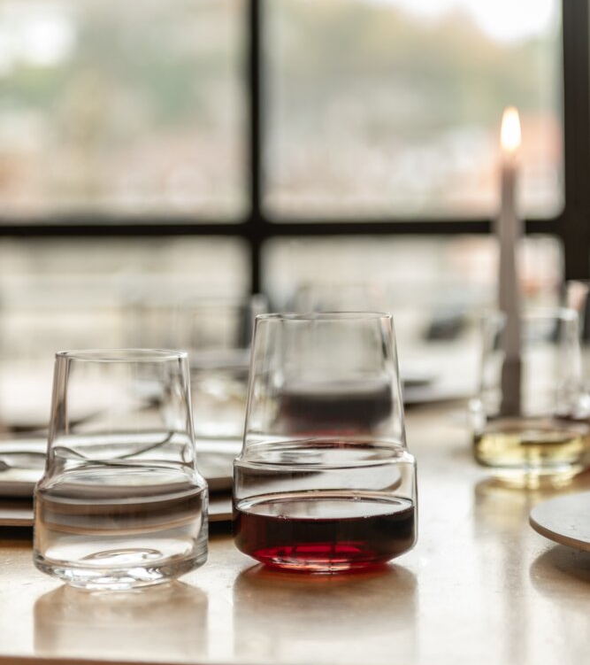
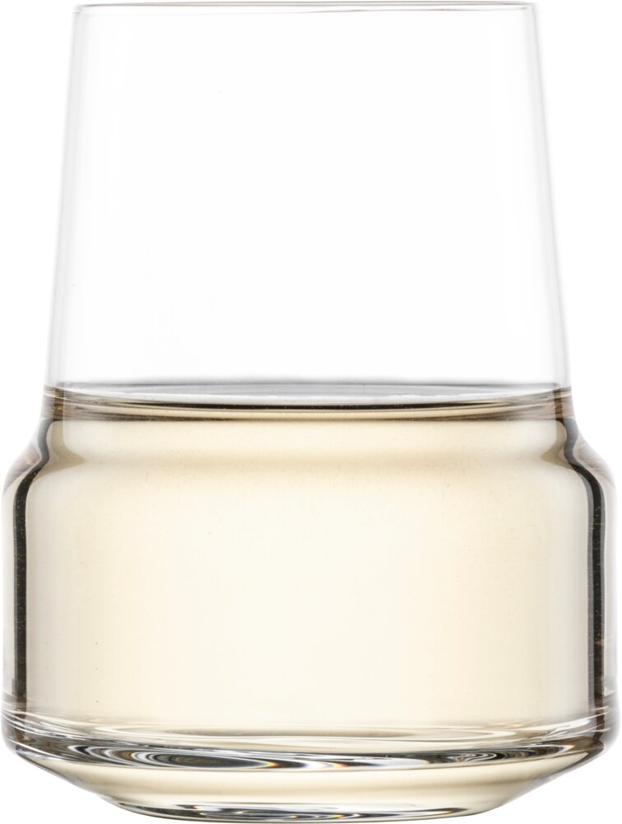
Zwiesel Glas – UP tumblers
On stock now!
123915 Red Wine tumbler 55 cl
123919 White Wine tumbler 37,8 cl
123922 Sparkling Wine tumbler 41,2 cl

Slide 17
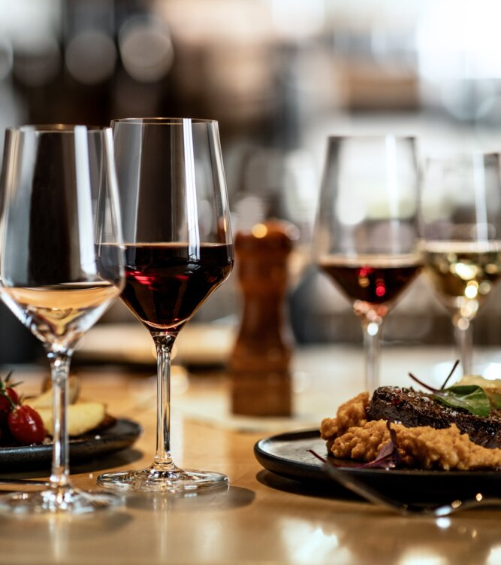
Zwiesel Glas - CINCO
New banqueting line.
On stock now!
123783 White wine 32,6 cl
123779 Universal 43,2 cl
123777 Red Wine 53 cl
123781 Allround 61,7 cl
123786 Sparkling 24,4 cl

Slide 18
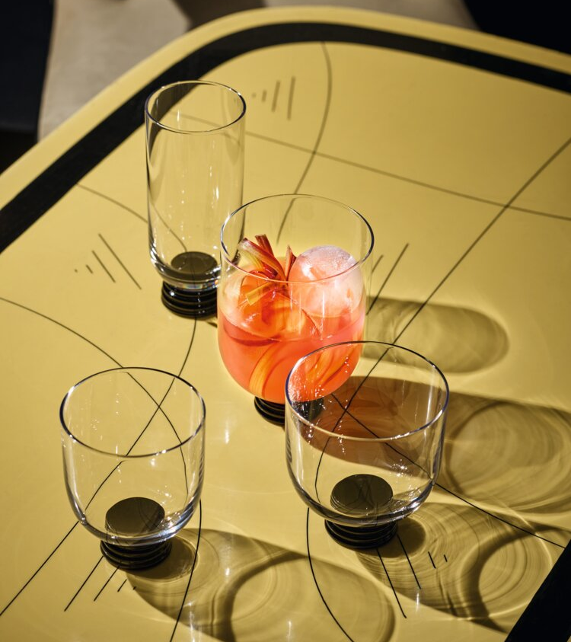
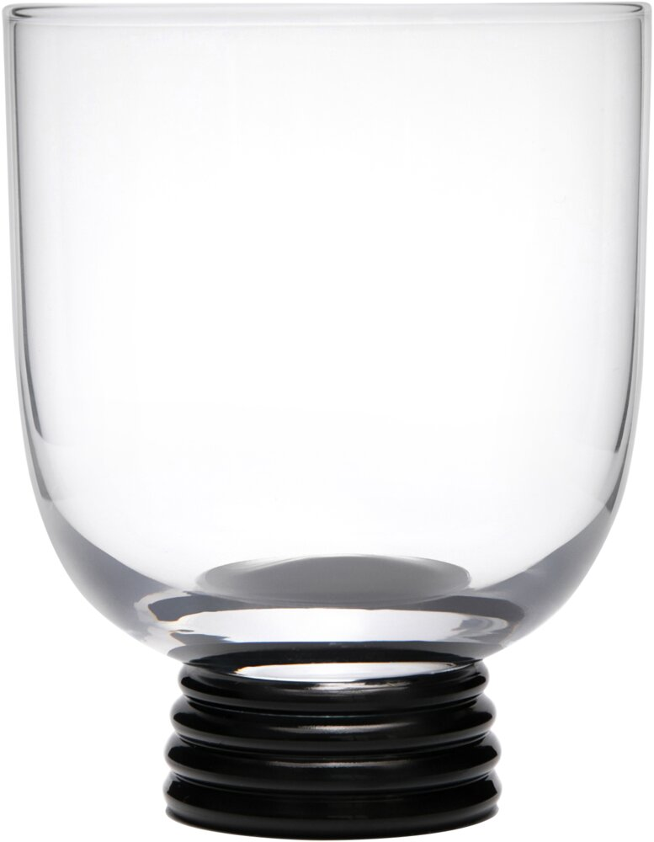
United Tables - TREVI
Fine wines in a multifaceted presentation! The TREVI red wine glass ensures an experience with all the senses when visiting a restaurant. Inspired by the iconic "Römer" glasses that adorned German tables for generations, we breathe new life into the long-standing tradition.

